Slide 1

Company insights
Part 1: web scraping
Date – 18/09/2023

Slide 2
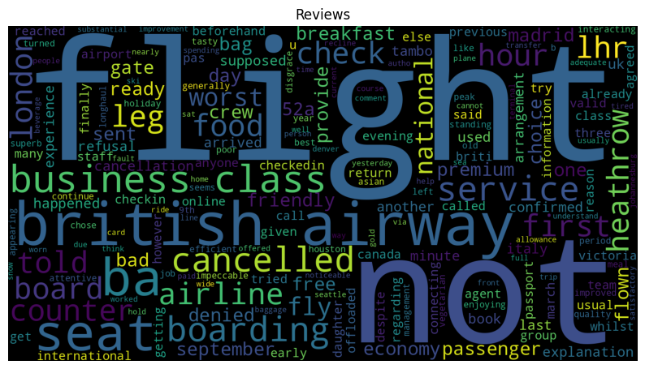
INSIGHTS FROM CUSTOMER REVIEWS
A total of 3650 reviews was gathered from Skytra
1523 submitted reviews were unfilled.
filled reviews was used for
this analysis
Word cloud of keywords used in reviews.
This are the most frequent words used in the
reviews gathered

Slide 3
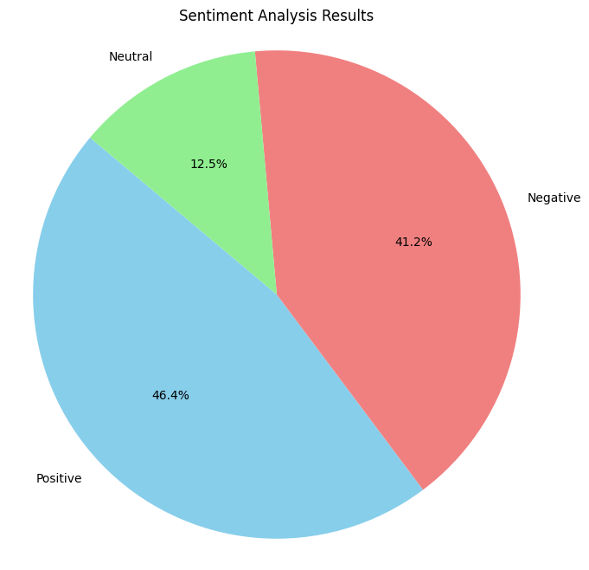
REVIEWS Sentiments
From the analysis of the 2127 reviews filled by the customers, these results were obtained
Positive Reviews - 986
Negative Reviews - 876
Neutral Reviews – 265

